Slide 1
COSC 4351 Project Demo
Chase arenas
Han pham
Kevin toan tran

Slide 2



MERN Stack
Front End: React
Back End: Node JS
Database: MongoDB

Slide 3
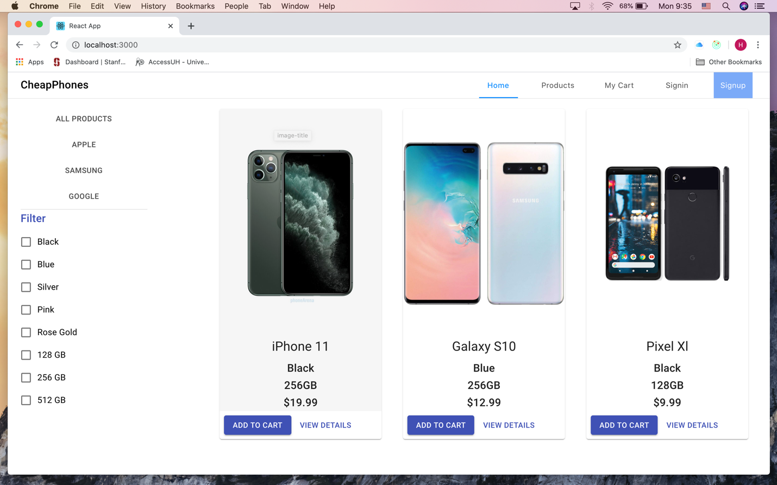
Home Page

Slide 4
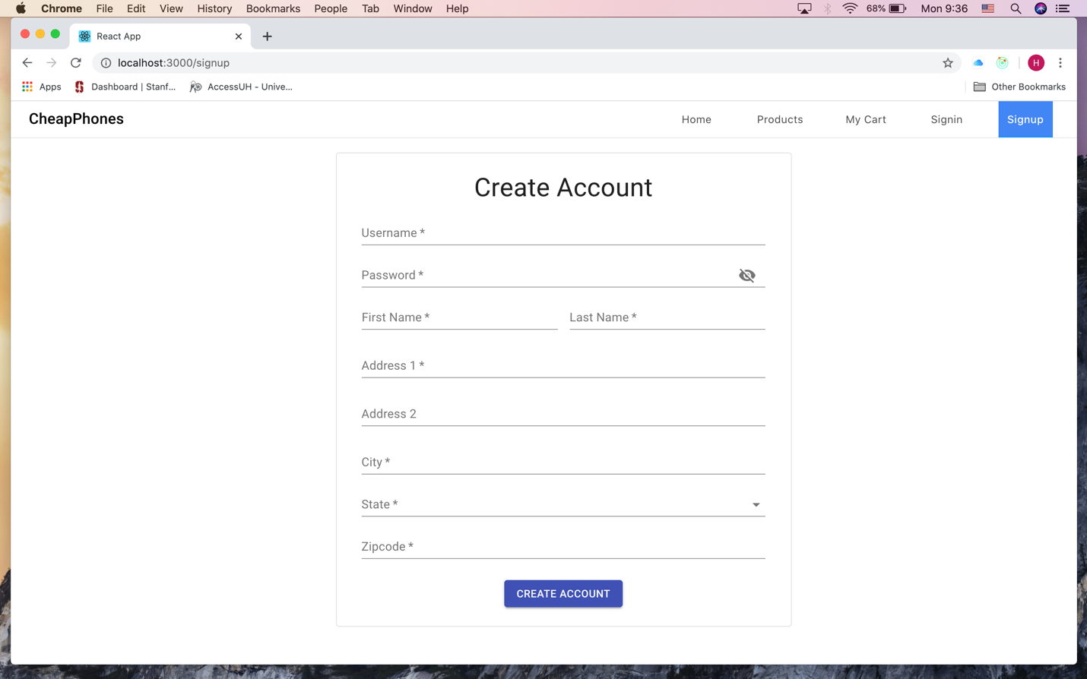
Sign-Up Page

Slide 5
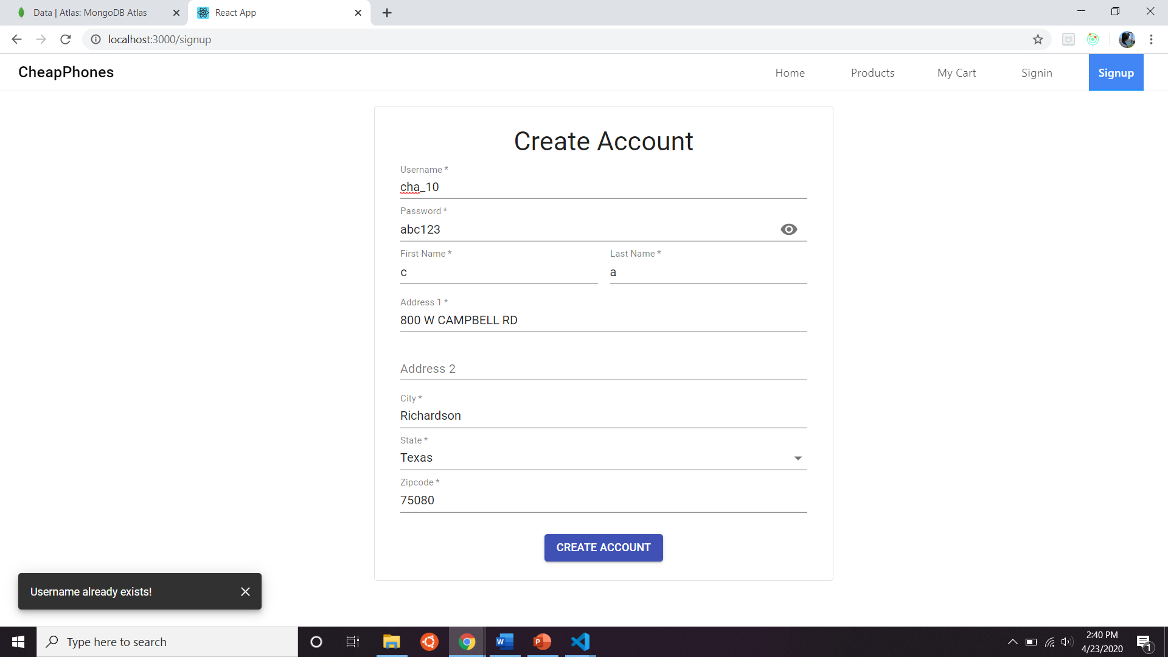
Unsuccessful Sign-Up
*If username is already in the database

Slide 6
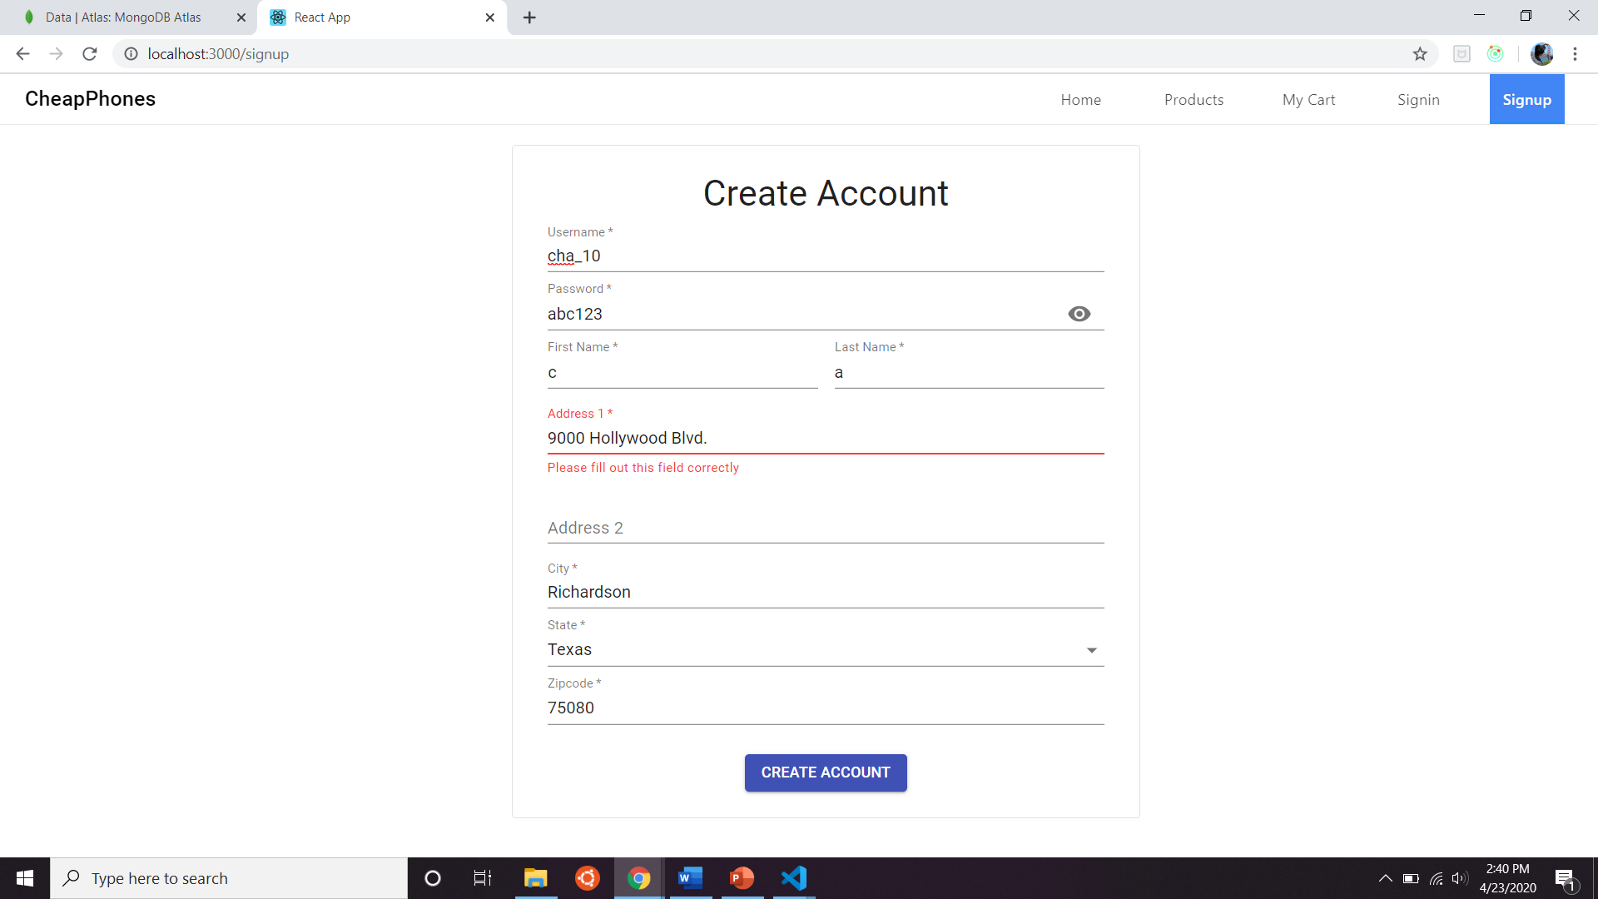
Unsuccessful Sign-Up
*If you enter an invalid address

Slide 7
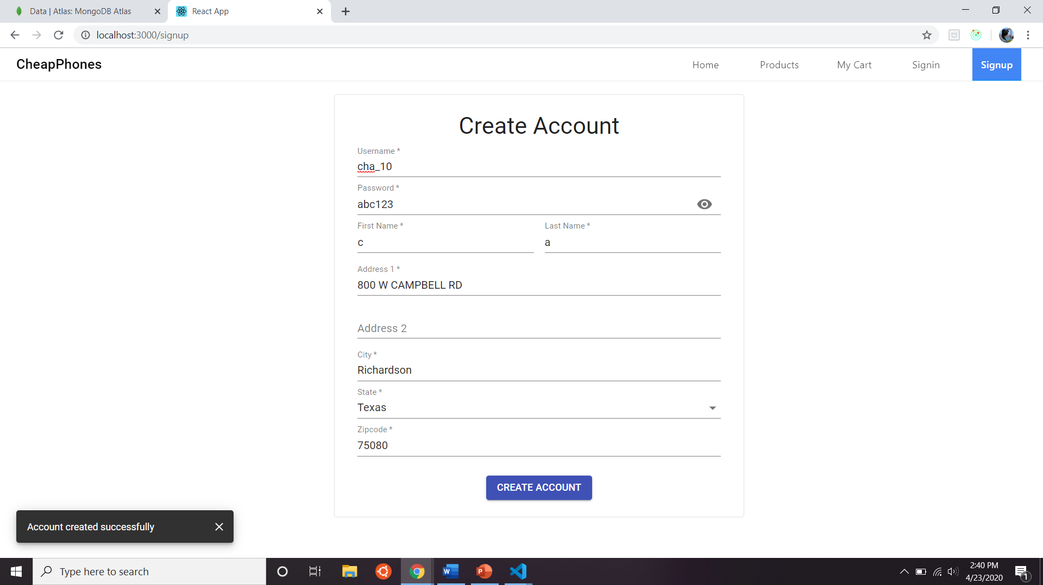
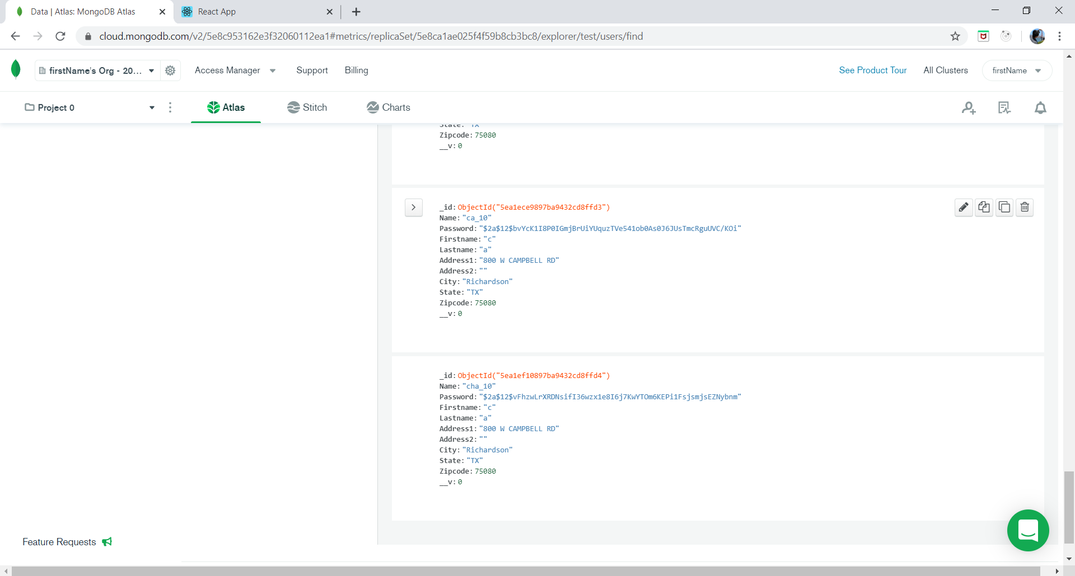
Successful Sign-Up

Slide 8
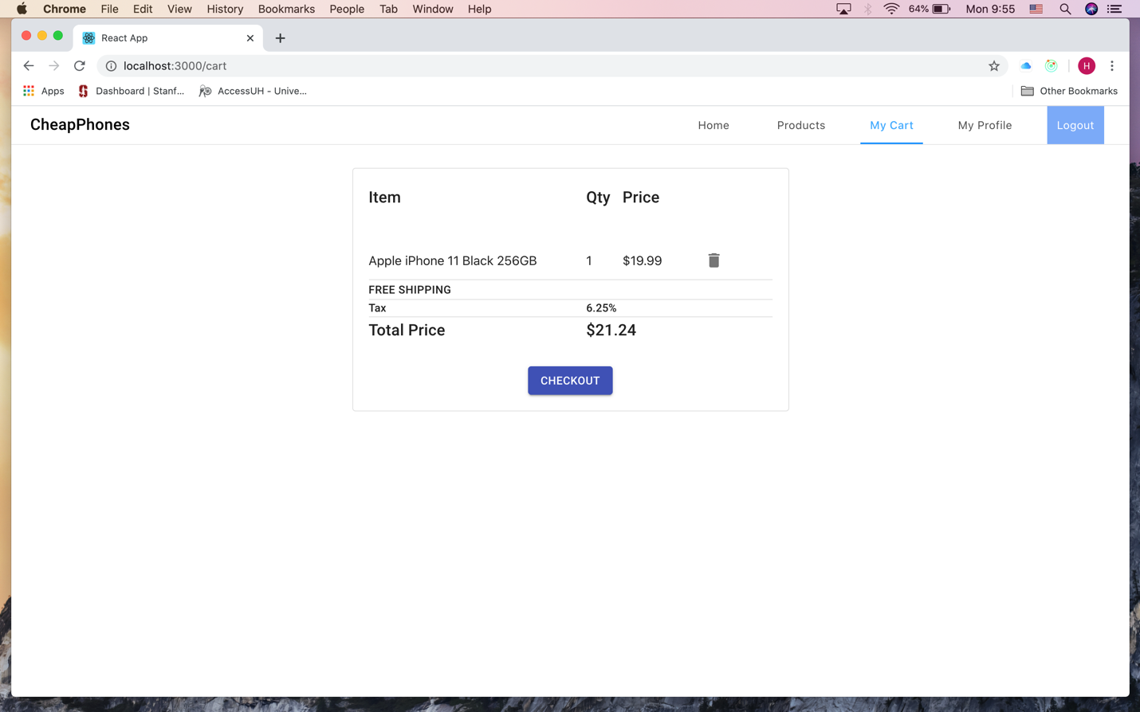
Shopping Cart

Slide 9
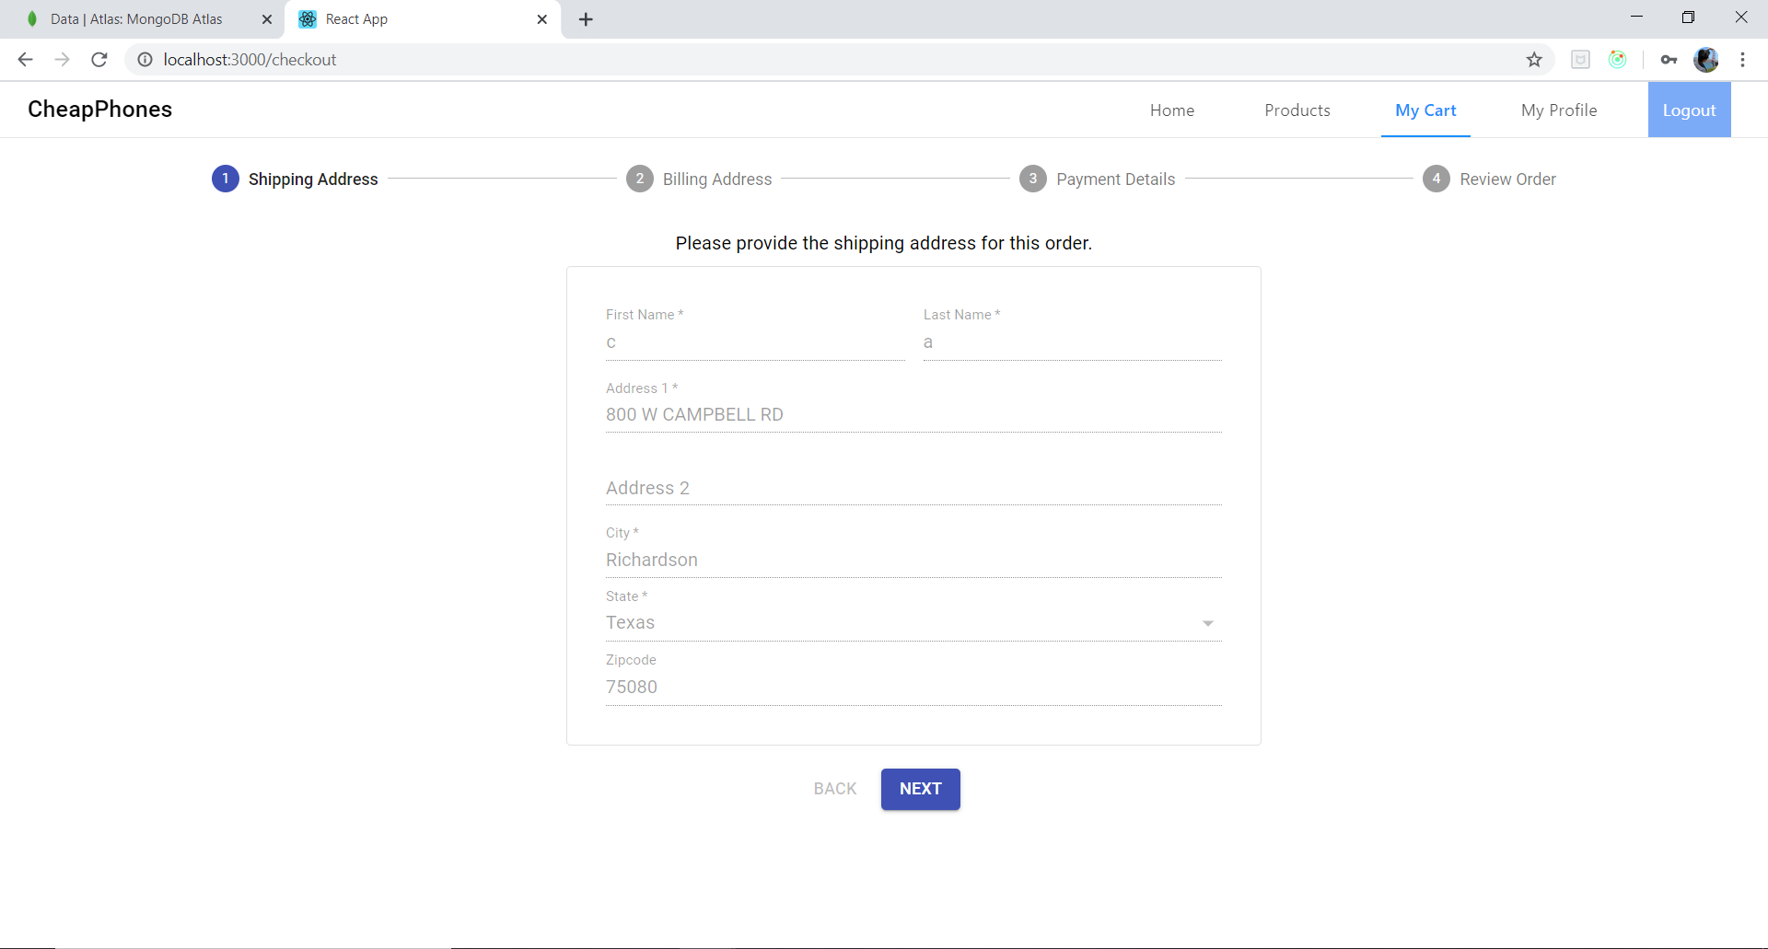
Checkout

Slide 10
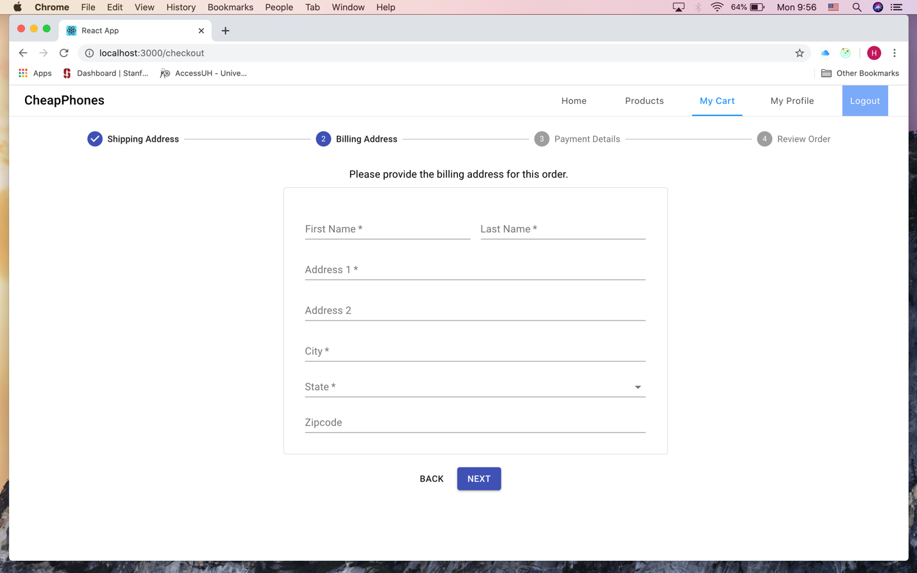

Slide 11
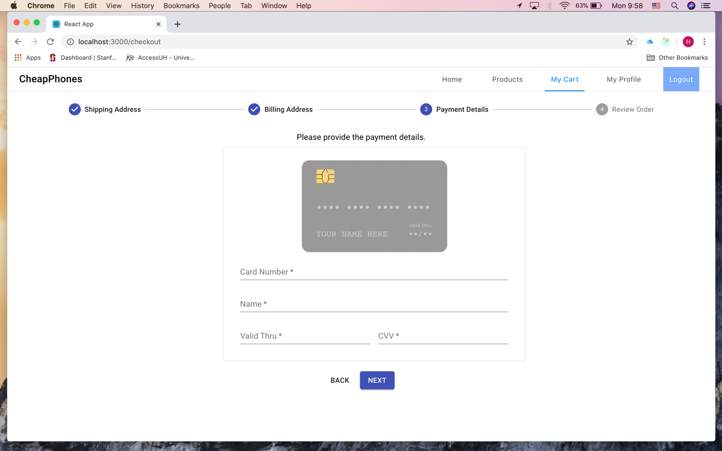

Slide 12
